Slide 1

ĐẠI HỌC CÔNG NGHIỆP HÀ NỘI
KHOA CÔNG NGHỆ THÔNG TIN
ĐỒ ÁN TỐT NGHIỆP
Sinh viên: Nguyễn Hoàng Long
MSV: 2020600528
GVHD: TS. Phạm Văn Hà
Đồ án tốt nghiệp
Hà Nội, ngày 29 tháng 5 năm 2024
Khoa công nghệ thông tin

Slide 2
ĐẠI HỌC CÔNG NGHIỆP HÀ NỘI
KHOA CÔNG NGHỆ THÔNG TIN
ĐỀ TÀI: XÂY DỰNG HỆ THỐNG XỬ LÝ DỮ LIỆU REAL-TIME SỬ DỤNG CONFLUENT PLATFORM

Slide 3
Nội dung chính:
01.
02.
Tổng quan đề tài
Phân tích, thiết kế hệ thống xử lý dữ liệu
03.
04.
Hướng phát triển
Demo sản phẩm

Slide 4
01.
Tổng quan đề tài

Slide 5
Lý do chọn đề tài
Mong muốn đưa ra 1 giải pháp đáp ứng nhu cầu của doanh nghiệp, tổ chức về :
Xử lý định dạng dữ liệu và các giao thức truyền tải dữ liệu không đồng nhất từ nhiều nguồn dữ liệu khác nhau
Yêu cầu tính thời gian thực của dữ liệu
Trung gian phân luồng giữa các hệ thống nguồn và đích
=> Xây dựng hệ thống xử lý dữ liệu thời gian thực sử dụng Confluent Platform

Slide 6



Công nghệ sử dụng
1
2
3

Slide 7

Phân tích thiết kế mô hình hệ thoogns xử lý dữ liệu real-time Confluent Platform
Triển khai, cài đặt hệ thống xử lý dữ liệu real-time Confluent Platform
Tích hợp Object Storage MinIO
Elaborate on what you want to discuss.
Tích hợp hệ thống giám sát Grafana
Mục tiêu
Elaborate on what you want to discuss.

Slide 8
Thành phần cơ bản của Confluent
— Include a credit, citation, or supporting message

Slide 9
Chú thích:

Slide 10
02.
Phân tích, thiết kế

Slide 11
Yêu cầu hệ thống:

Slide 12
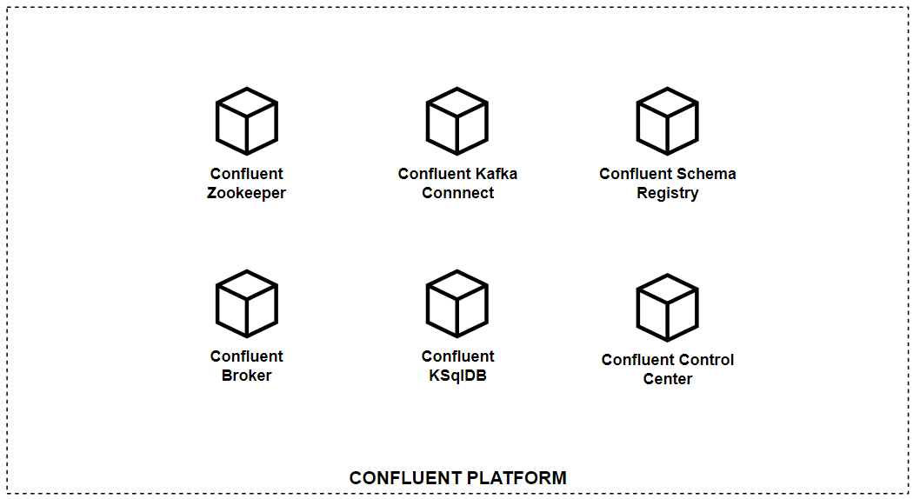
Các thành phần mà Confluent cung cấp

Slide 13
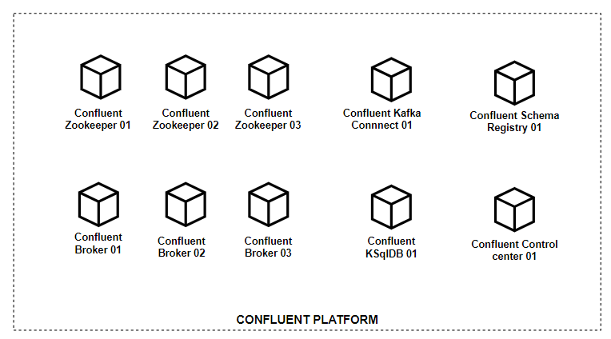
Đề xuất các thành phần

Slide 14
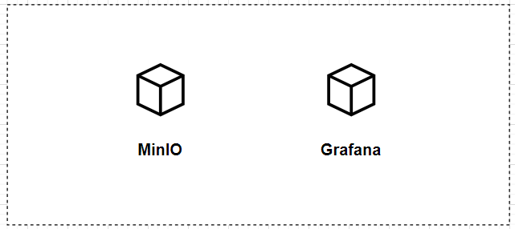
Đề xuất tích hợp

Slide 15
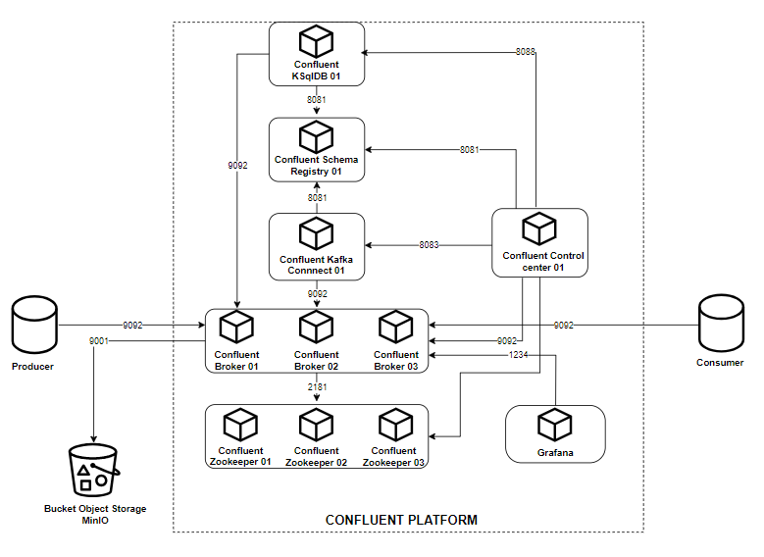
Yêu cầu hệ thống:

Slide 16
03.
Hướng phát triển

Slide 17
04.
Demo sản phẩm

Slide 18

thank you!
Write a closing statement or call-to-action here.

Slide 19
Chuẩn bị câu hỏi phản biện

Slide 20
pretitle
title
Paragraph 1 Present with ease and wow any audience with Canva Presentations. Choose from over a thousand professionally-made templates to fit any objective or topic. Make it your own by customizing it with text and photos.
subtitle
heading 1
heading 2
Paragraph 2 Present with ease and wow any audience with Canva Presentations. Choose from over a thousand professionally-made templates to fit any objective or topic. Make it your own by customizing it with text and photos.
heading 3
heading 4
heading 5
heading 6
footer

Slide 21
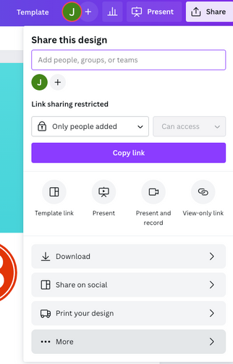
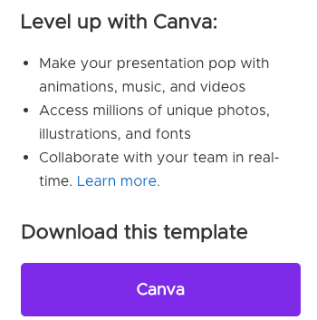
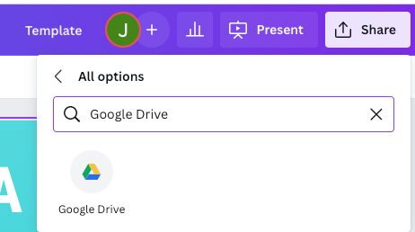
download this presentation as
a Google Slides template in 3 steps
1
2
3
Click on the "Canva" button next to this presentation. Start editing your presentation. You may need to sign in to your Canva account.
Click on the "Share" button on the top right corner in Canva and click on "More" at the bottom of the menu.
Enter "Google Drive" in the search bar and click on the Google Drive icon to add this design as a Google slide in your G Drive. It will ask you to link your Google account to Canva the first time.

Slide 22

about me
I'm Rain.
Welcome to my education presentation.
Follow me at @reallygreatsite to learn more.

Slide 23

write your
topic or idea
Elaborate on what you want to discuss.

Slide 24


write your topic or idea
Add a main point
Add a main point
Briefly elaborate on what you want to discuss.
Briefly elaborate on what you want to discuss.
Add a main point
Add a main point
Briefly elaborate on what you want to discuss.
Briefly elaborate on what you want to discuss.

Slide 25
write your topic or idea
Add a main point
Briefly elaborate on what you want to discuss.
Add a main point
Briefly elaborate on what you want to discuss.
Add a main point
Briefly elaborate on what you want to discuss.
Add a main point
Briefly elaborate on what you want to discuss.
Add a main point
Briefly elaborate on what you want to discuss.
Add a main point
Briefly elaborate on what you want to discuss.

Slide 26

methodology
add a main point
add a main point
add a main point
Elaborate on what you want to discuss.
Elaborate on what you want to discuss.
Elaborate on what you want to discuss.

Slide 27
04.
section name

Slide 28

2 out of 5
95%
12 million
Elaborate on the featured statistic.
Elaborate on the featured statistic.
Elaborate on the featured statistic.

Slide 29
schedule
1ST QUARTER
January
Double click to add task
February
Double click to add task
March
Double click to add task
2ND QUARTER
April
Double click to add task
May
Double click to add task
June
Double click to add task
3RD QUARTER
July
Double click to add task
August
Double click to add task
September
Double click to add task
4TH QUARTER
October
Double click to add task
November
Double click to add task
December
Double click to add task

Slide 30
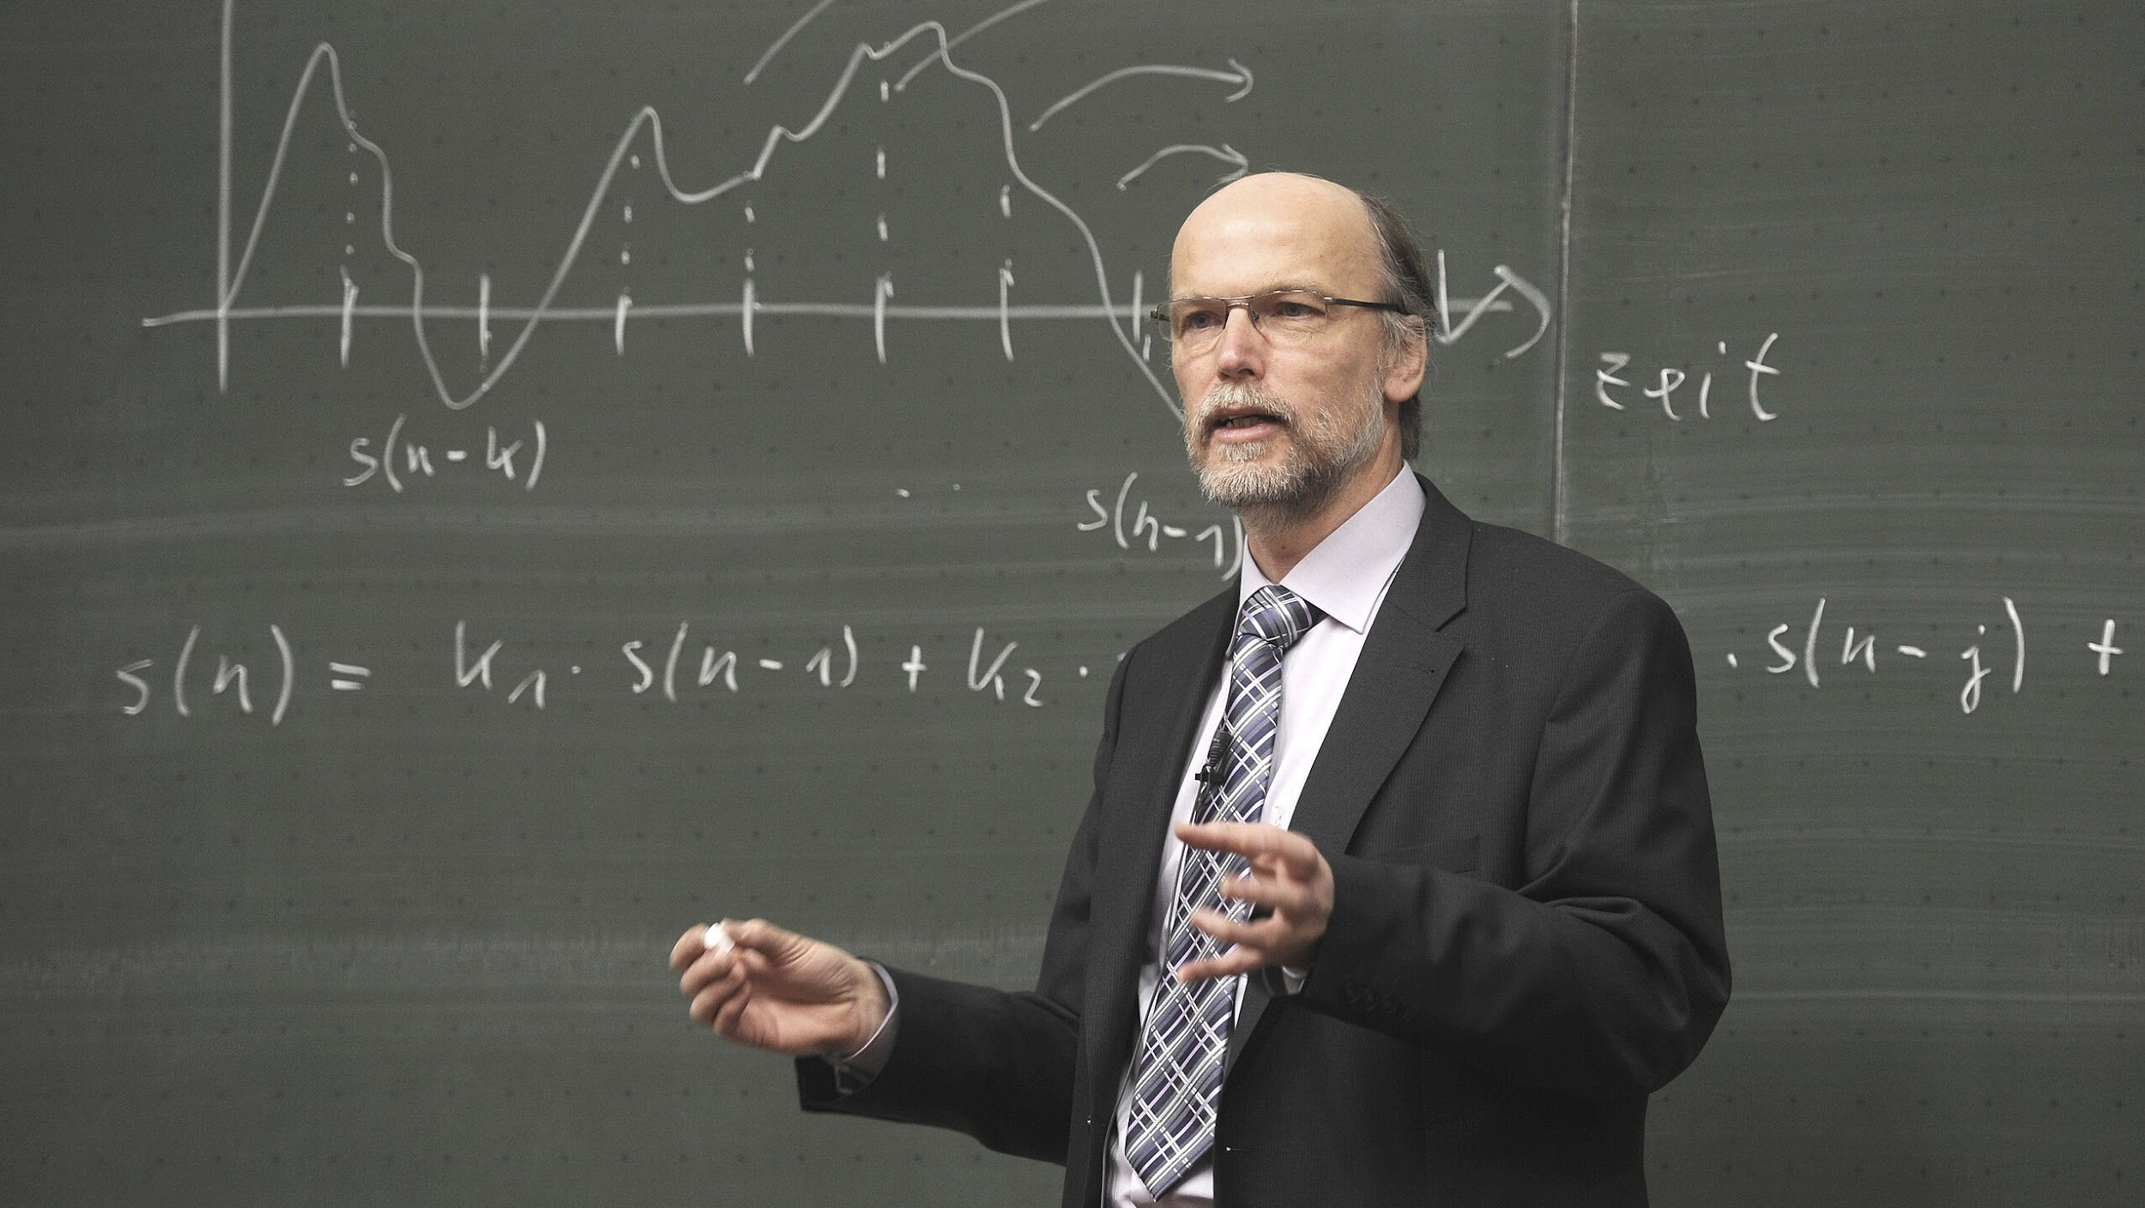
write a heading here

Slide 31


Write a caption for
the photos.

Slide 32




add a team
members page
Elaborate on what you want to discuss.
Name
Name
Name
Name
Title or Position
Title or Position
Title or Position
Title or Position

Slide 33

get in touch
Email
hello@reallygreatsite.com
Social Media
@reallygreatsite
Call us
123-456-7890

Slide 34
This presentation template is free for everyone to use thanks to the following:
SlidesCarnival for the presentation template
Pexels for the photos
happy designing!
credits

Slide 35



This presentation template uses the following free fonts:
Titles: Playfair Display Black
Headers: Roboto
Body Copy: Roboto
You can find these fonts online too.
Happy designing!
fonts in this presentation

Slide 36
add a timeline page
Add a main point
Add a main point
Add a main point
Elaborate on what you want to discuss.
Elaborate on what you want to discuss.
Elaborate on what you want to discuss.
Add a main point
Add a main point
Add a main point
Elaborate on what you want to discuss.
Elaborate on what you want to discuss.
Elaborate on what you want to discuss.

Slide 37
swot analysis
S
O
What are you doing well?
What sets you apart?
What are your good qualities?
What are your goals?
Are demands shifting?
How can it be improved?
Where do you need
to improve?
Are resources adequate?
What do others do better than you?
W
T
What are the blockers
you're facing?
What are factors outside of
your control?

Slide 38

analysis of the results
25
20
Elaborate on what you want to discuss.
15
10
5
0
Item 1
Item 2
Item 3
Item 4
Item 5

Slide 39
Name
add a chart page
Job Title
Name
Name
Job Title
Job Title
Name
Name
Name
Name
Job Title
Job Title
Job Title
Job Title

Slide 40







































resource
page
Use these design resources in your Canva Presentation. Happy designing!
Don't forget to delete this page before presenting.

Slide 41

free templates for all your presentation needs
For PowerPoint, Google Slides, and Canva
100% free for
personal or commercial use
Ready to use, professional, and customizable
Blow your audience away with attractive visuals

